Slide 1
Azure Data Manager for Energy

Slide 2

Azure Data Manager for Energy
Fully Managed
OSDU Data Platform
Simple and easy deployments
Seamless upgrades

Slide 3
Enterprise Fundamentals
Azure Data Manager for Energy will deliver on all the promises of a first-party Azure service, including, but not limited to:
Security – Private Links, CMEK, Encryption in-transit and at REST, Managed Identity, Audit Logs, Lockbox, all Secure Development Lifecycle checks.
Data – Data Residency, Data Privacy and Compliance.
Regions – North Europe, West Europe, East US, South Central US region supported at GA.
SLA – SLA of 99.9% for Production tier.
Availability – Business Continuity & Disaster Recovery via zonal and regional redundancy.
Manageability – OSDU service logs, Azure Monitor, Dynamic Data Partitions
Scalability – Azure Data Manager for Energy auto-scales with load, ensuring jobs get the right number of resources to complete.
Production and Developer Tiers with differentiated pricing to deploy as per customer needs.

Slide 4
Challenges in unlocking business value through data
Insights
Operational Efficiency
Global Scalability
Integration
Data sets in the energy industry are among the largest and most complex, with less than 5% used, making it difficult to generate meaningful insights
Too much time spent collecting and validating data and not enough time for strategic analysis and decision-making
Data bottlenecks and silos across diverse applications and businesses slow operations and workflows
Data searches and repurchases are expensive and time-consuming
Limited security and scalability compared to an integrated, open, enterprise-grade cloud with the power to compute intensive workloads at a global scale
Lack of extensibility to an ecosystem of additional industry applications, developers, and solutions
Data is bound to proprietary applications, making it difficult to integrate solutions and data for analysis, collaboration, and innovation
Lack of resources to build and support enterprise grade applications and technology capabilities

Slide 5

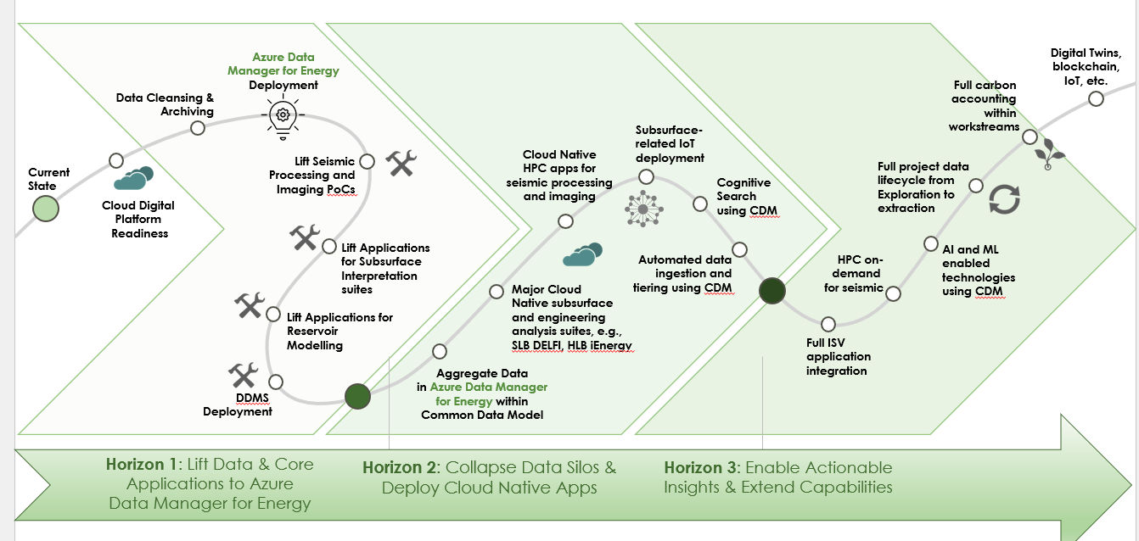
Azure Data Manager for Energy Evolution
Build industry capabilities to support transformation and energy transition in partnership with the global energy industry
Data platform to govern subsurface data types across the full project life-cycle from acquisition to production.
Using industry defined open data standards to unlock siloed data and liberate the data types across different applications.
Support for end-to-end domain workflows that predominantly are built using ISV applications and cloud solutions.
Connectivity for domain specific data across Microsoft offerings

Slide 6
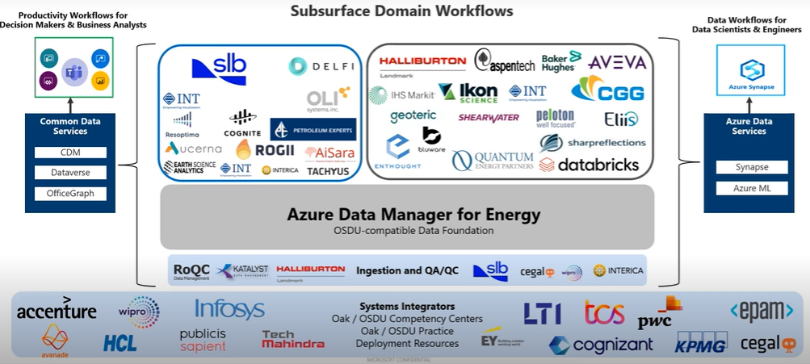


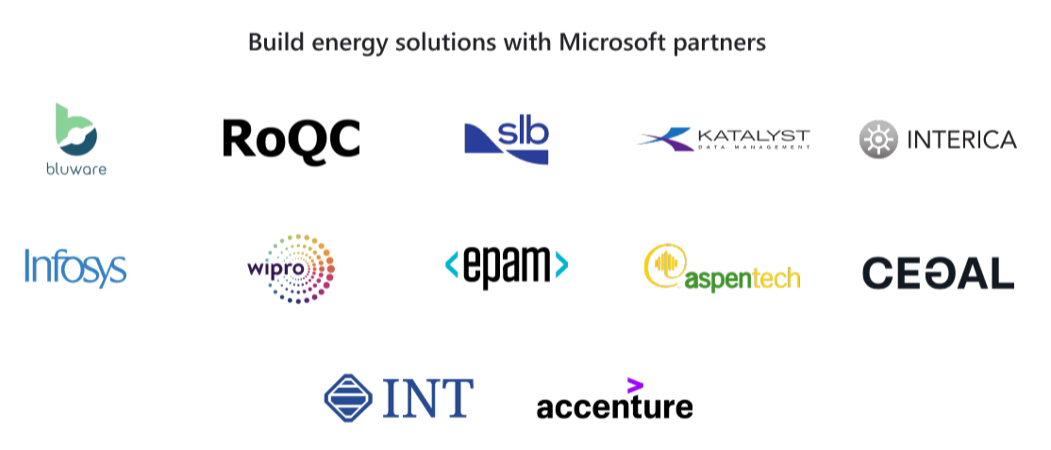






Open data platform with industry leading integrations
Open platform with built in integration and interoperability to clean, analyze, and visualize subsurface data with leading domain applications from multiple partners to break data silos and help bring in deeper insights.
A growing partner ecosystem of leading ISVs like AspenTech, Bluware, Cegal, ESA, Halliburton Landmark, INT, RoQC, QEP, Accenture, Interica, Wipro, and Katalyst, run applications on Azure Data Manager for Energy.

Slide 7
Azure Data Manager for Energy – Partner Capabilities Partner capabilities to deliver on now and in near term
GA Release
GA Release Scenarios | Post GA Release Scenarios – Future Roadmap
SLB: Analyze data from exploration to production with Petrel with data hosted in Azure Data Manager for Energy
SLB: Visualize wellbore data using Techlog and liberate data to Azure Data Manager for Energy
Halliburton: Data driven insights using Landmark DecisionSpace 365 applications
Support for applications from other leading ISVs such as AspenTech, Bluware, Cegal, ESA, INT, RoQC, QEP, Accenture, Interica, Wipro, Katalyst, etc.
SLB: Support for Enterprise Data Solutions for well log related scenarios.
SLB: Support for Enterprise Data Solutions for seismic related scenarios.
Support for OSDU Experimental services on Azure Data Manager for Energy

